Slide 1
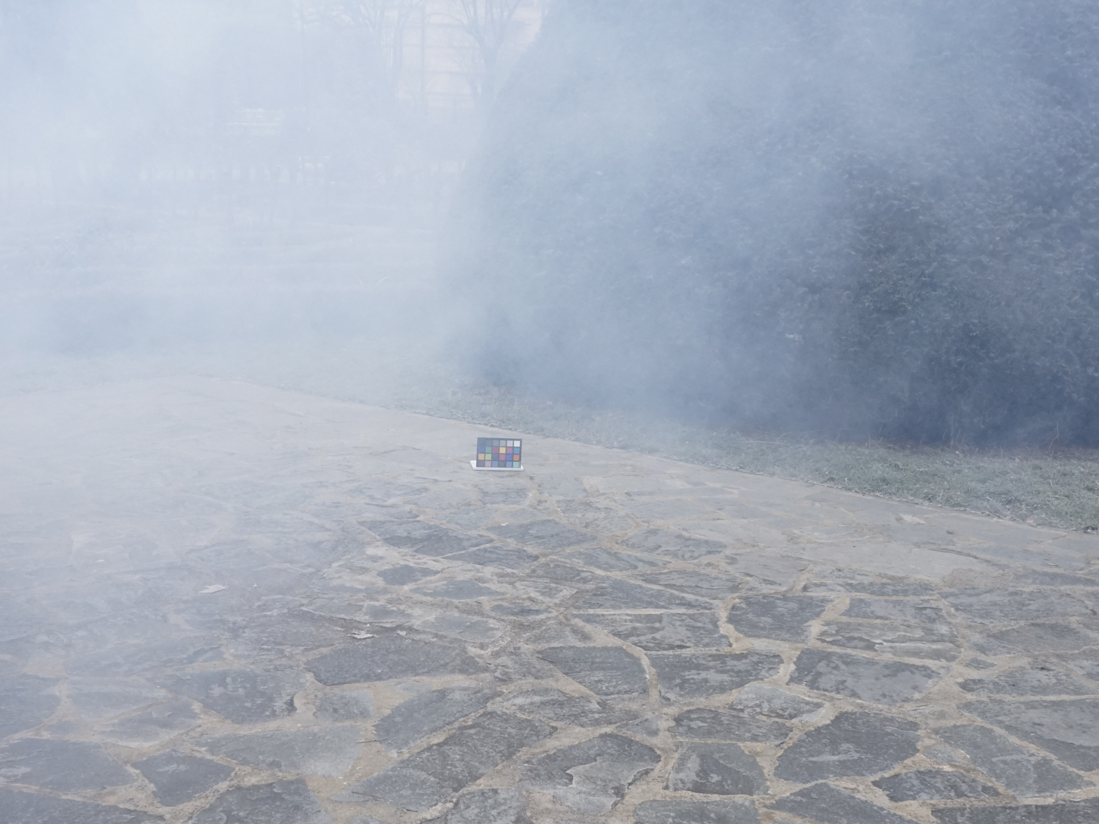
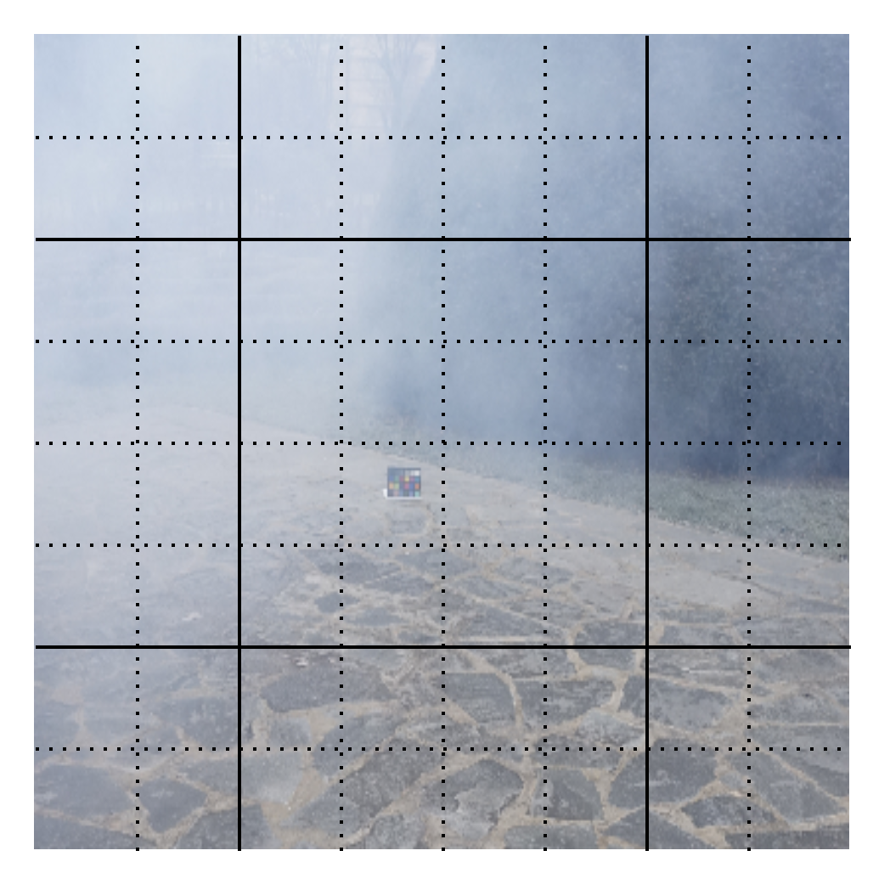

Slide 2
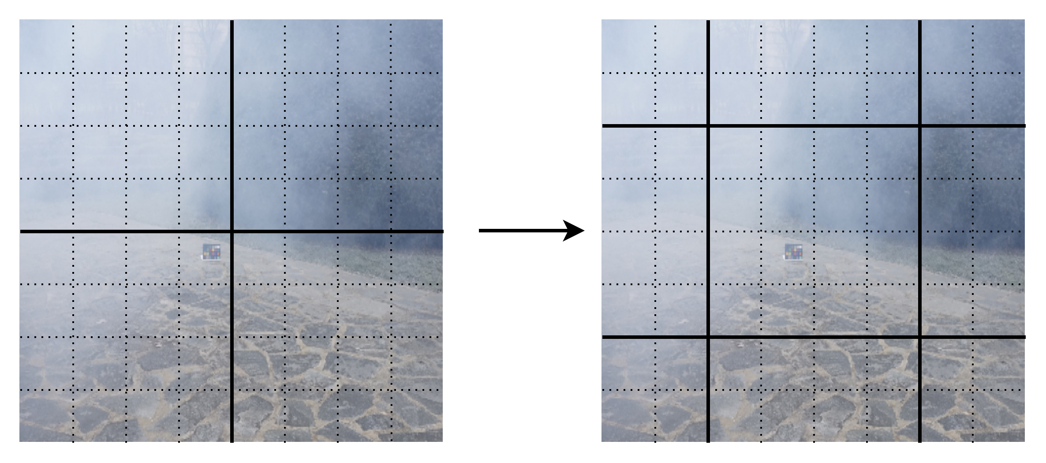
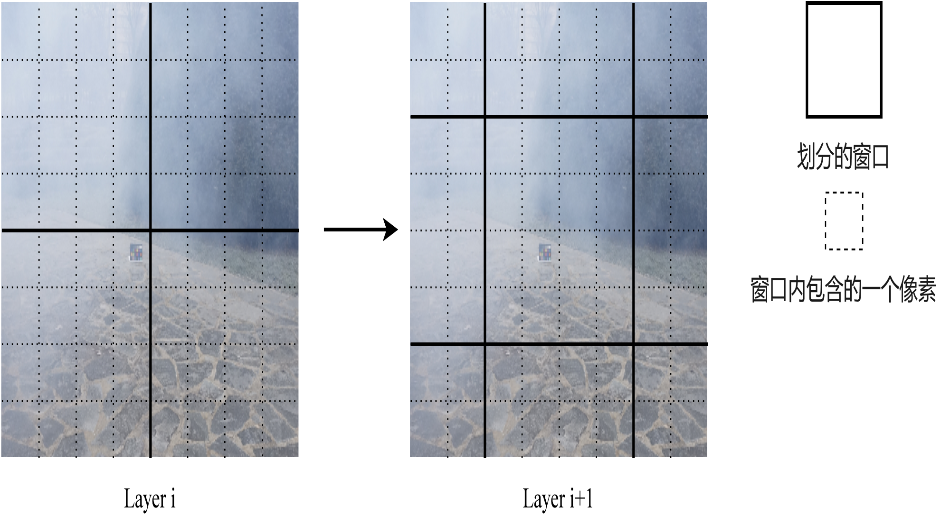
划分的窗口
Layer i
Layer i+1

Slide 3
-100
-100
softmax
-100
-100

Slide 4
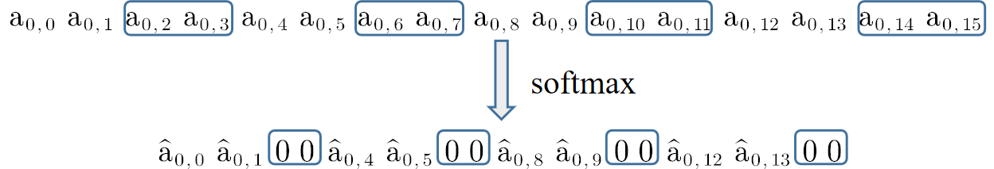

Slide 5
-100
-100
softmax
-100
-100

Slide 6
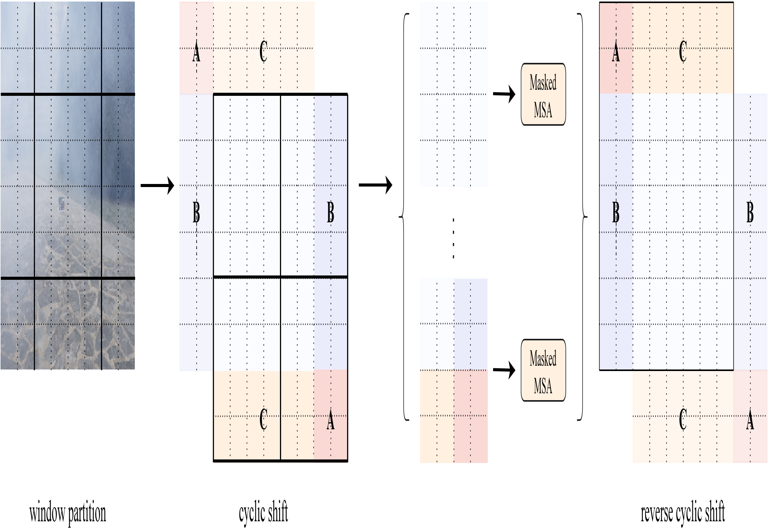

Slide 7
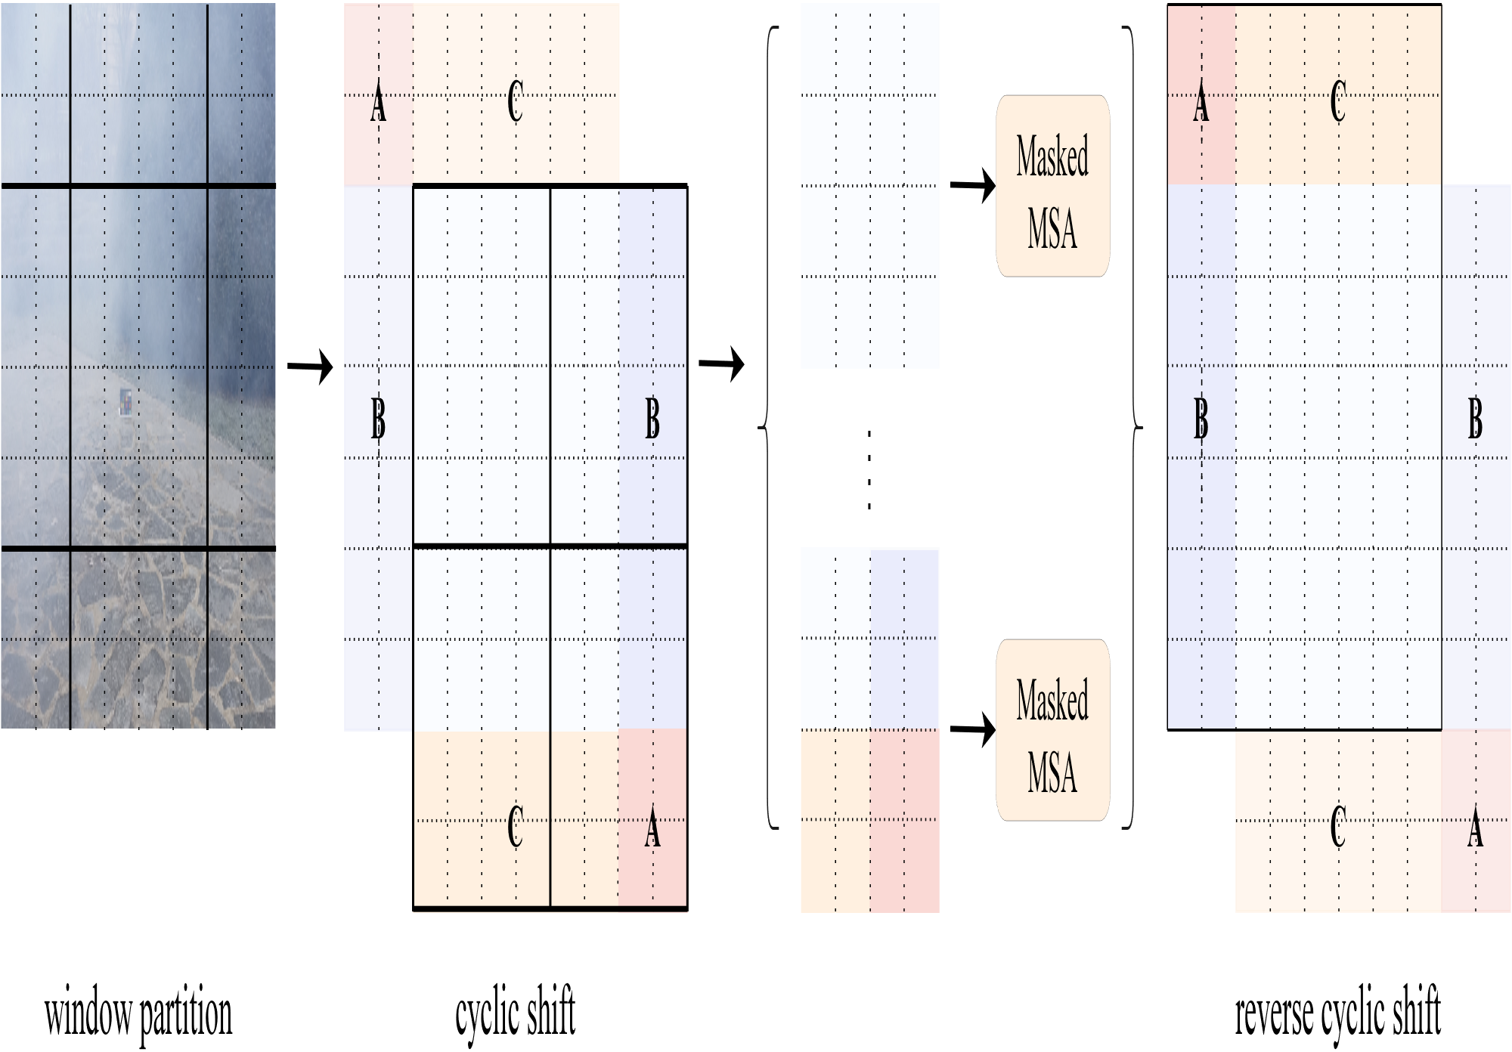

Slide 8
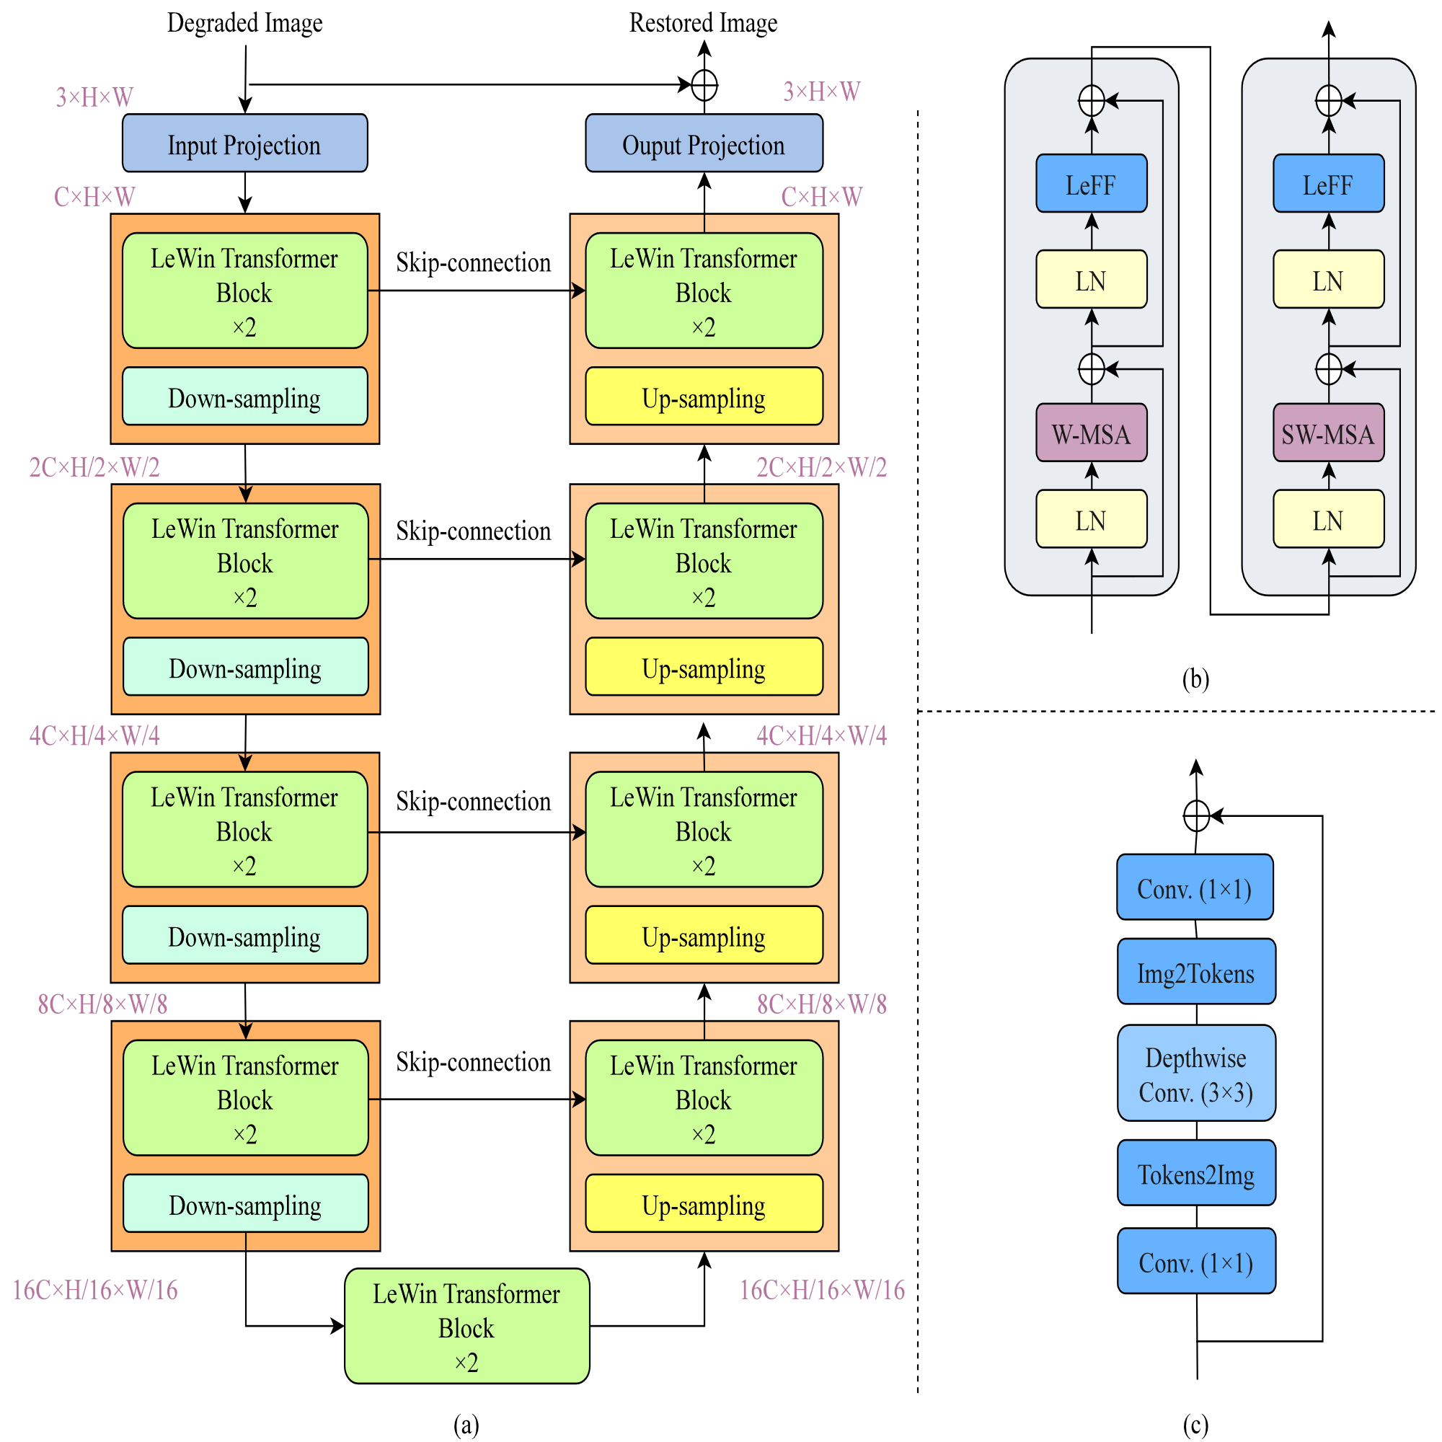

Slide 10
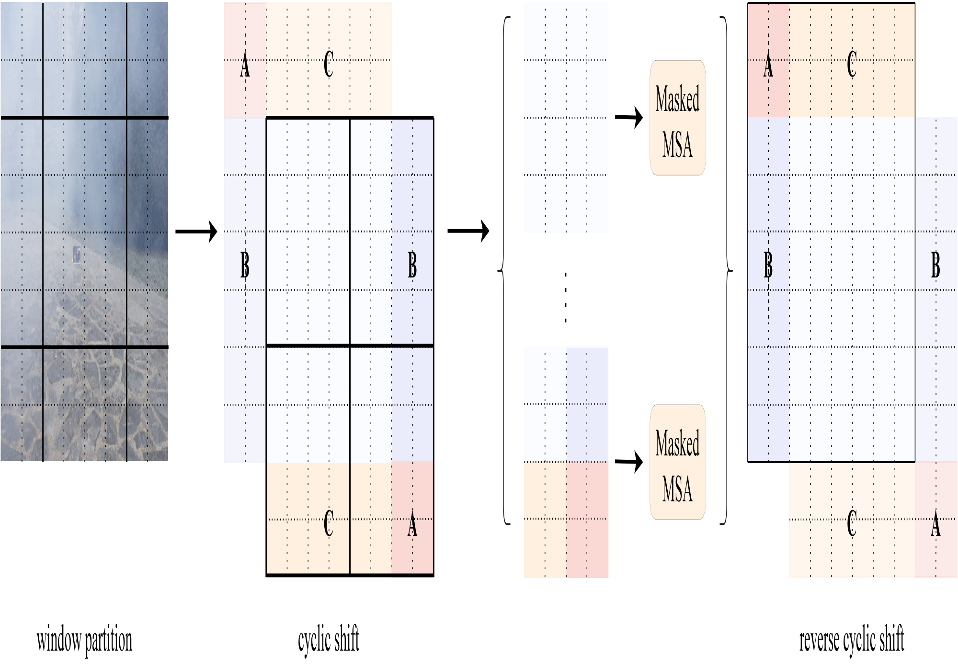

Slide 11
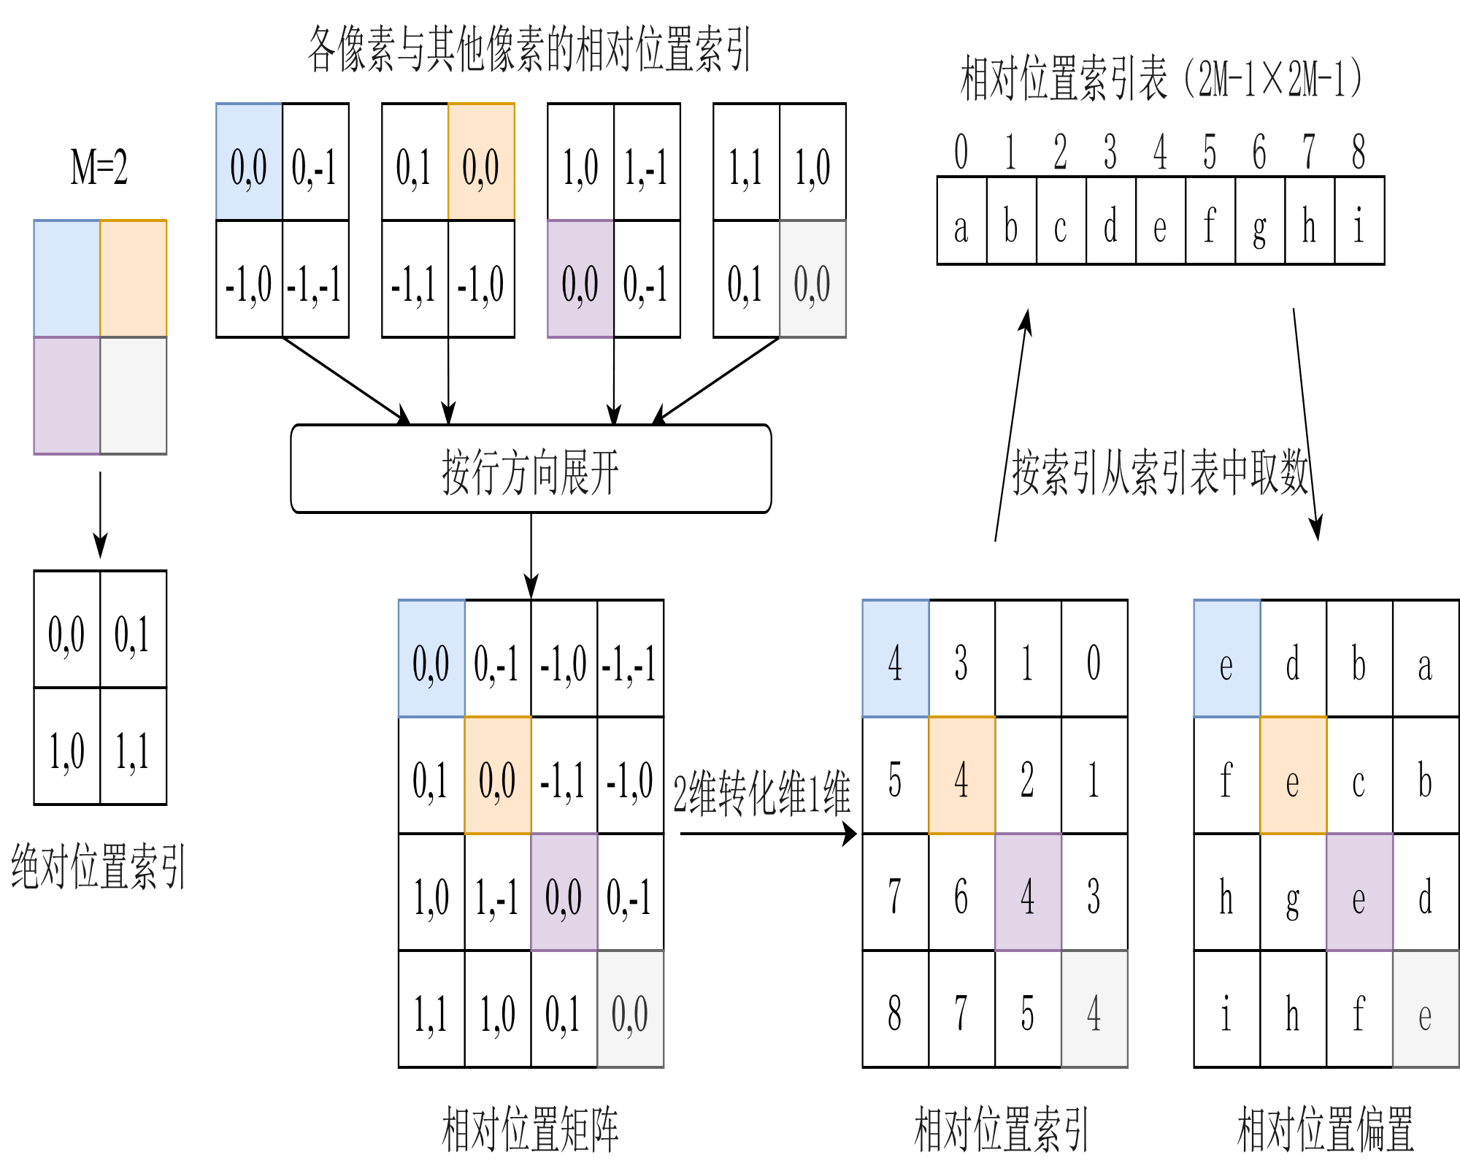

Slide 12
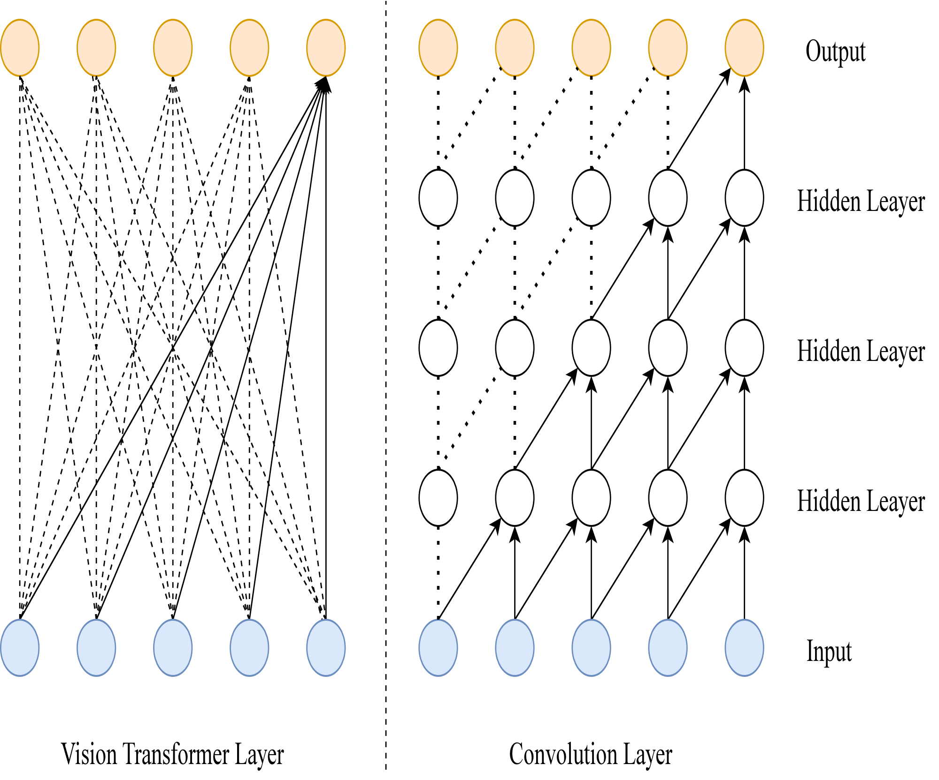

Slide 13
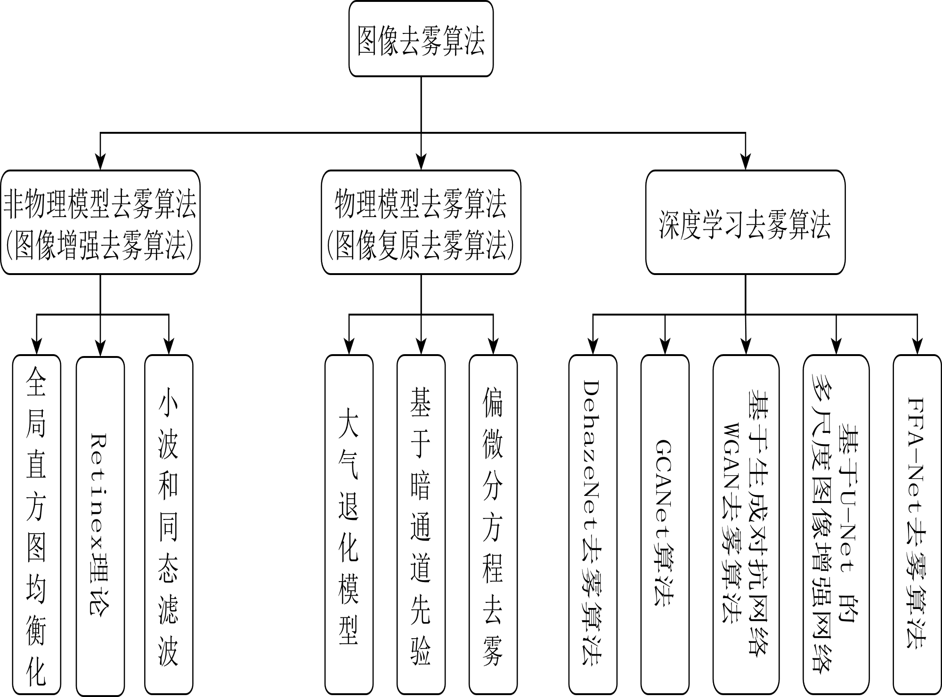

Slide 14
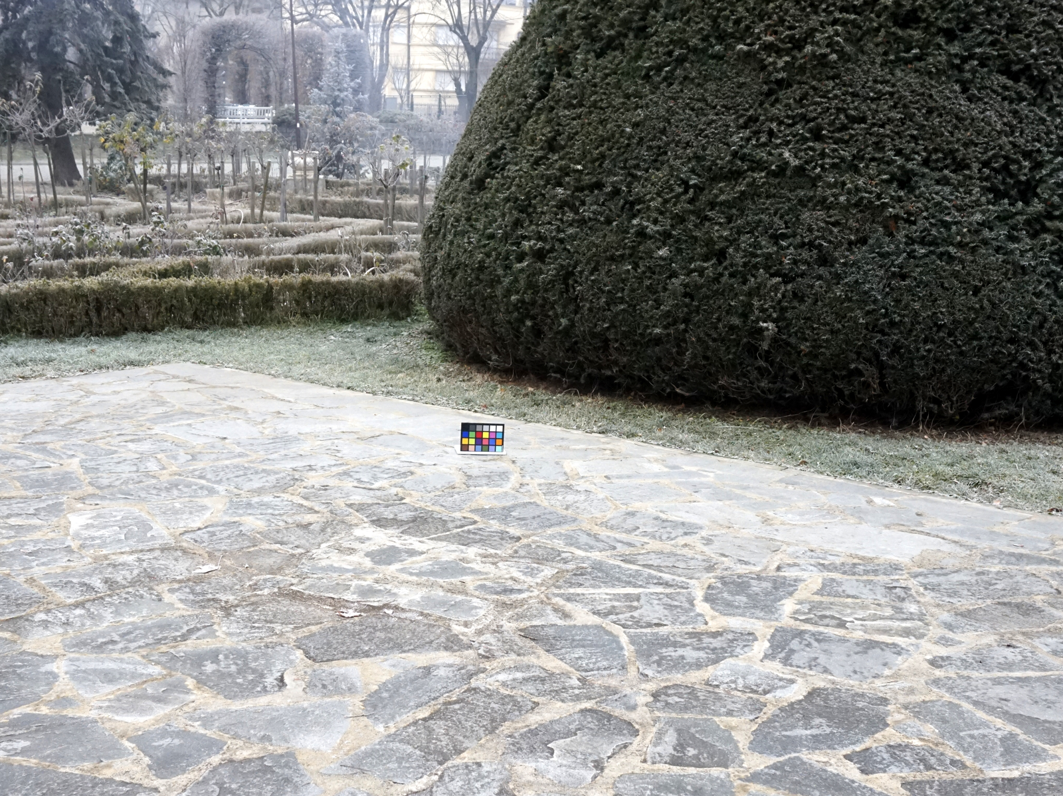
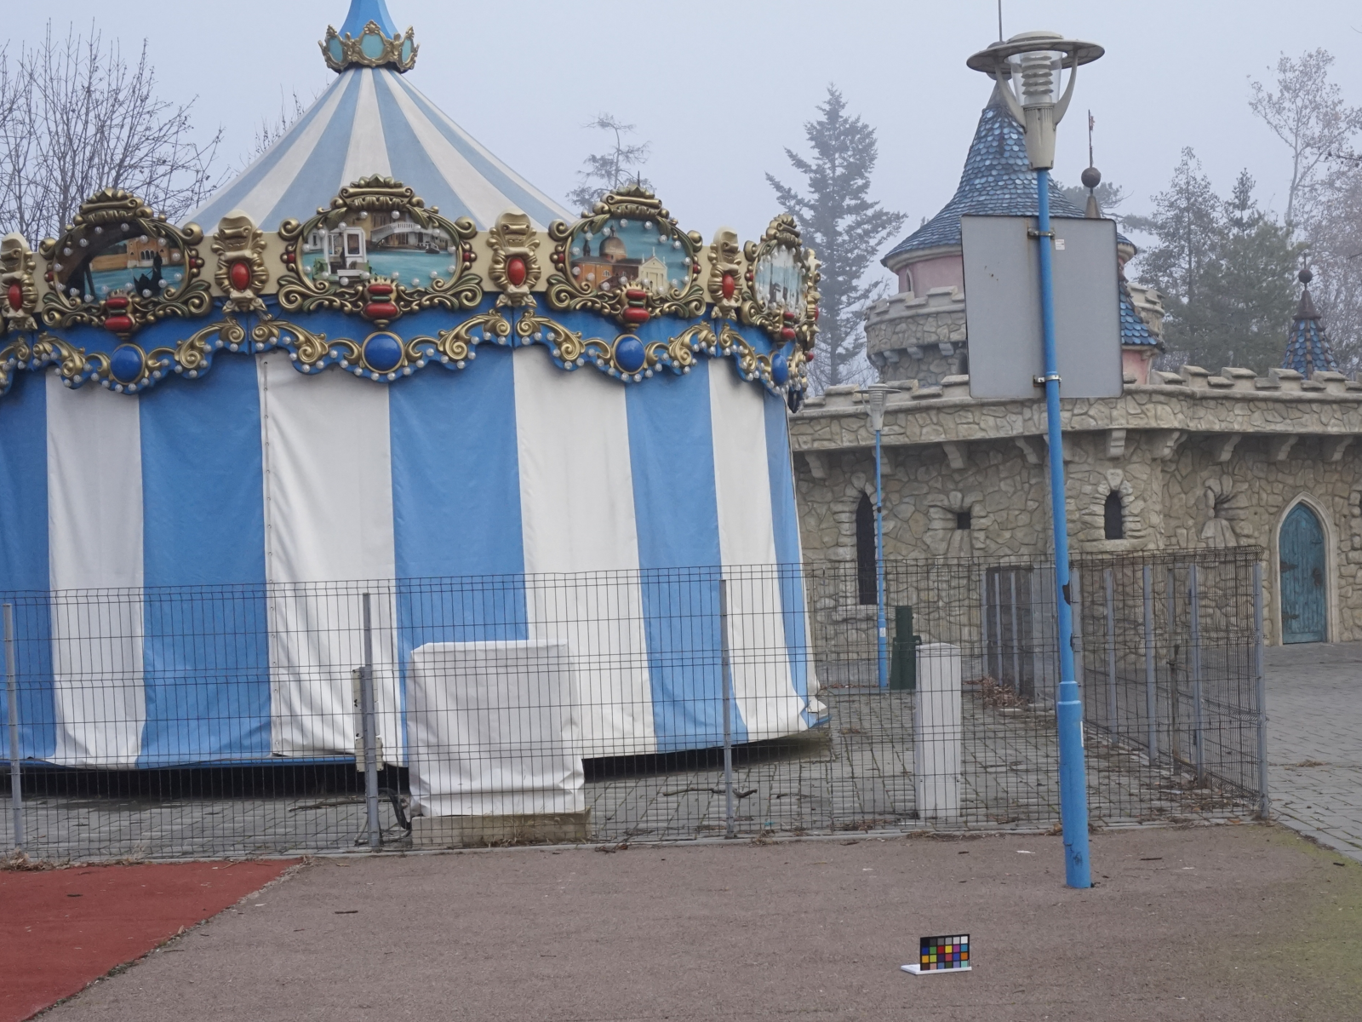
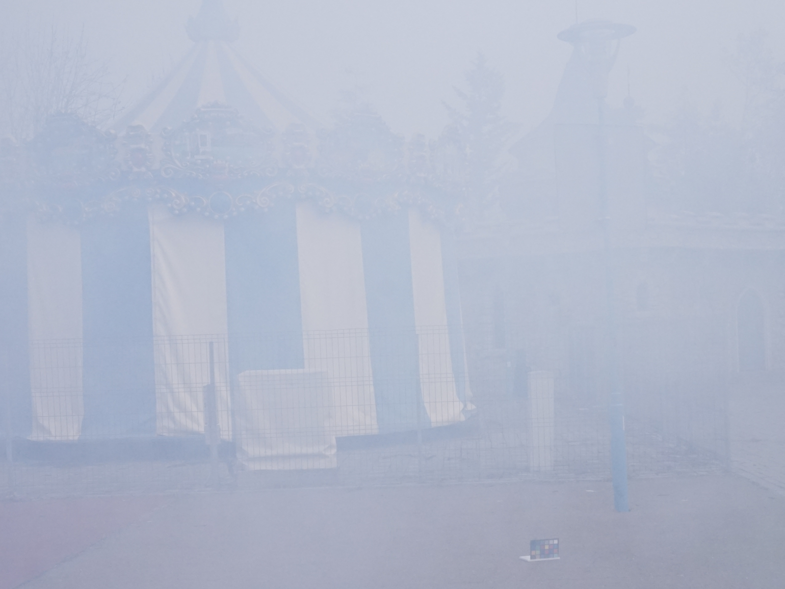
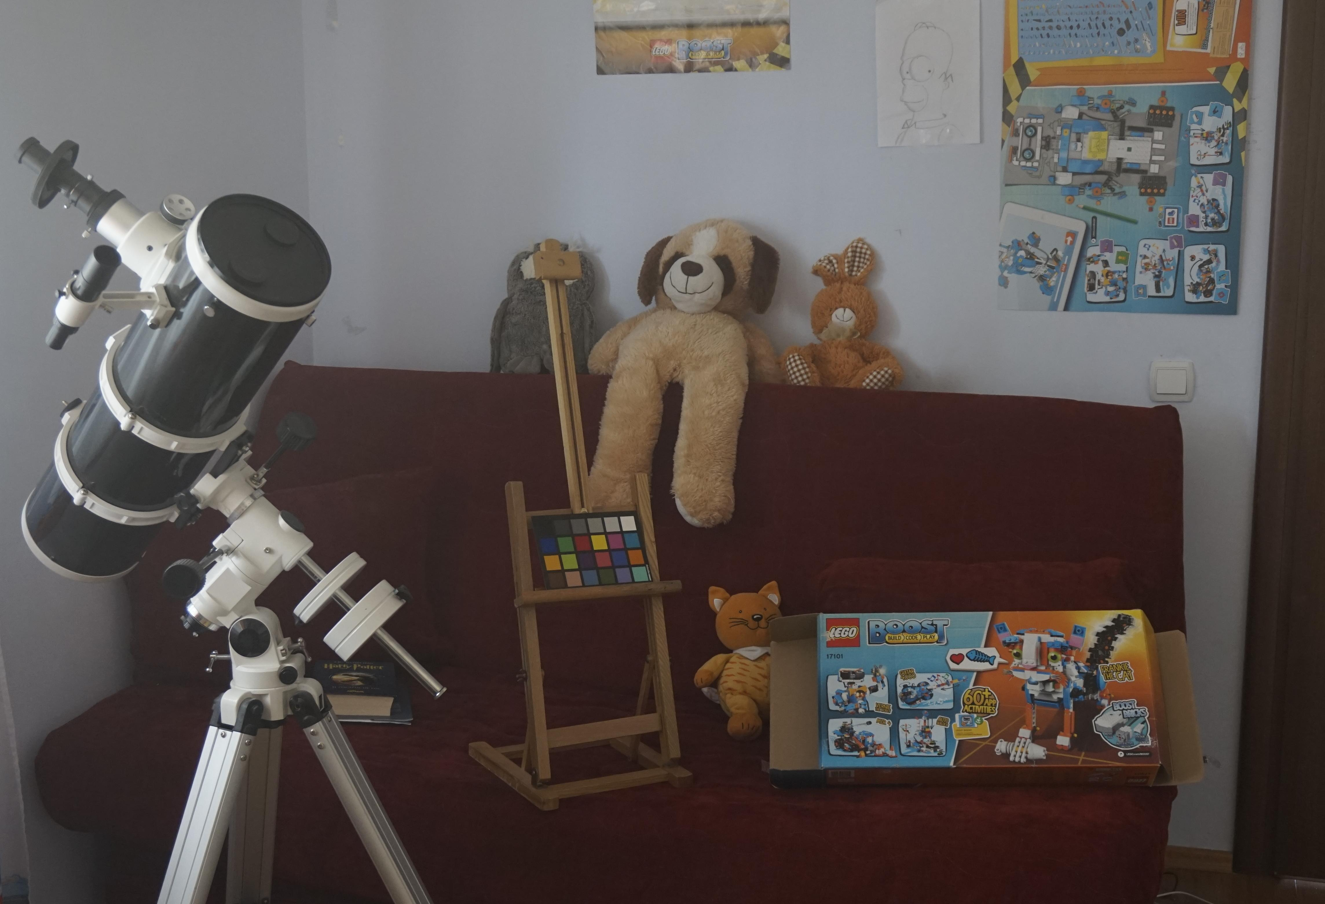
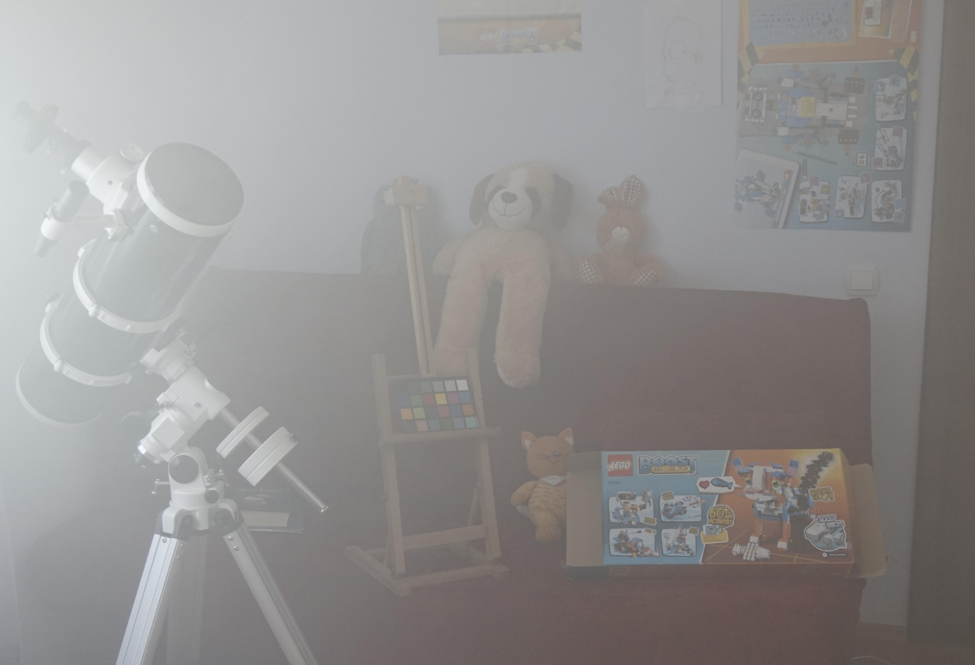
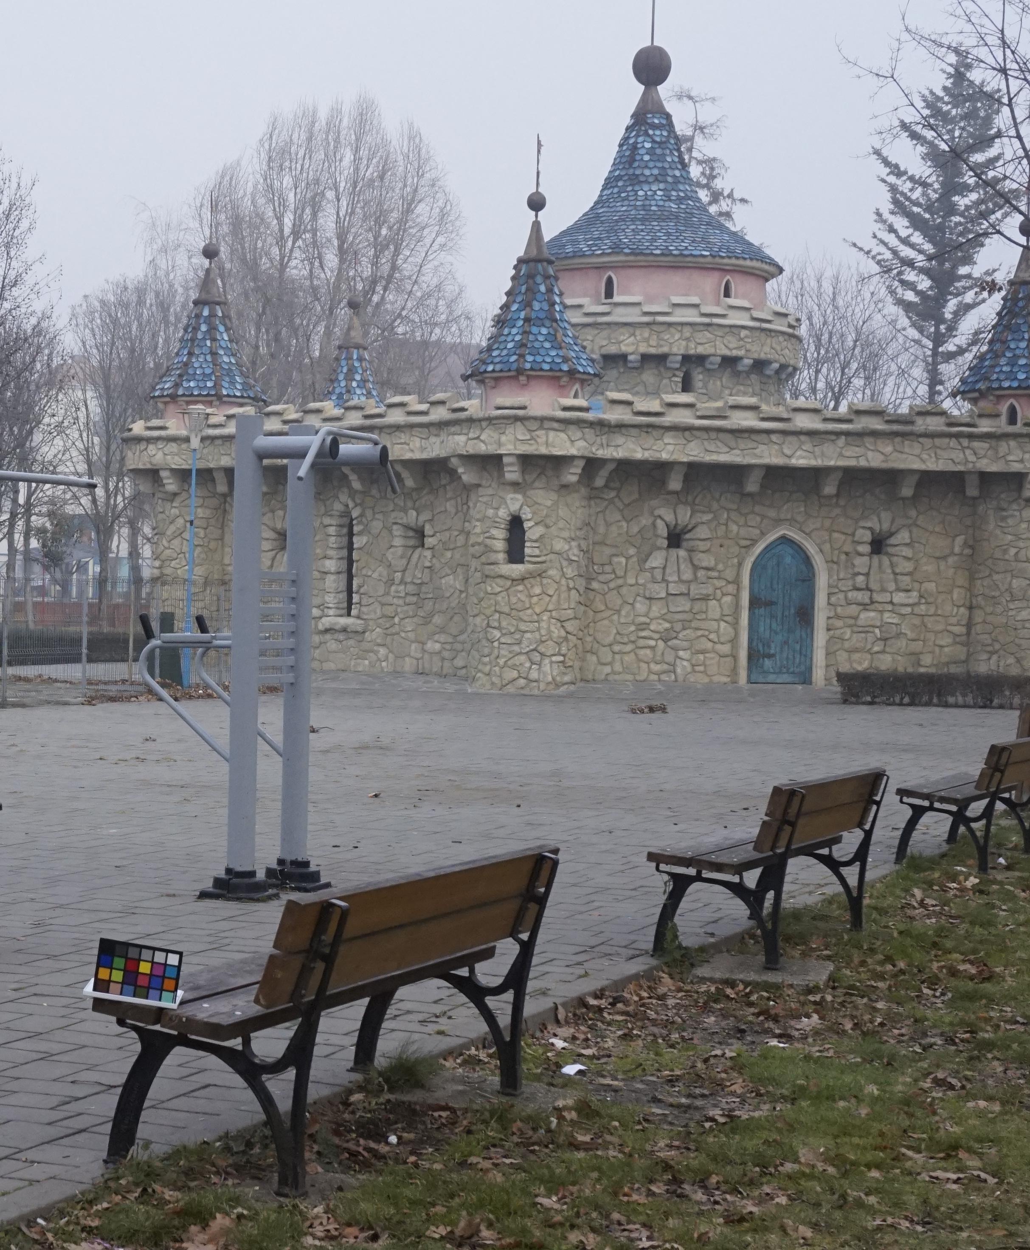
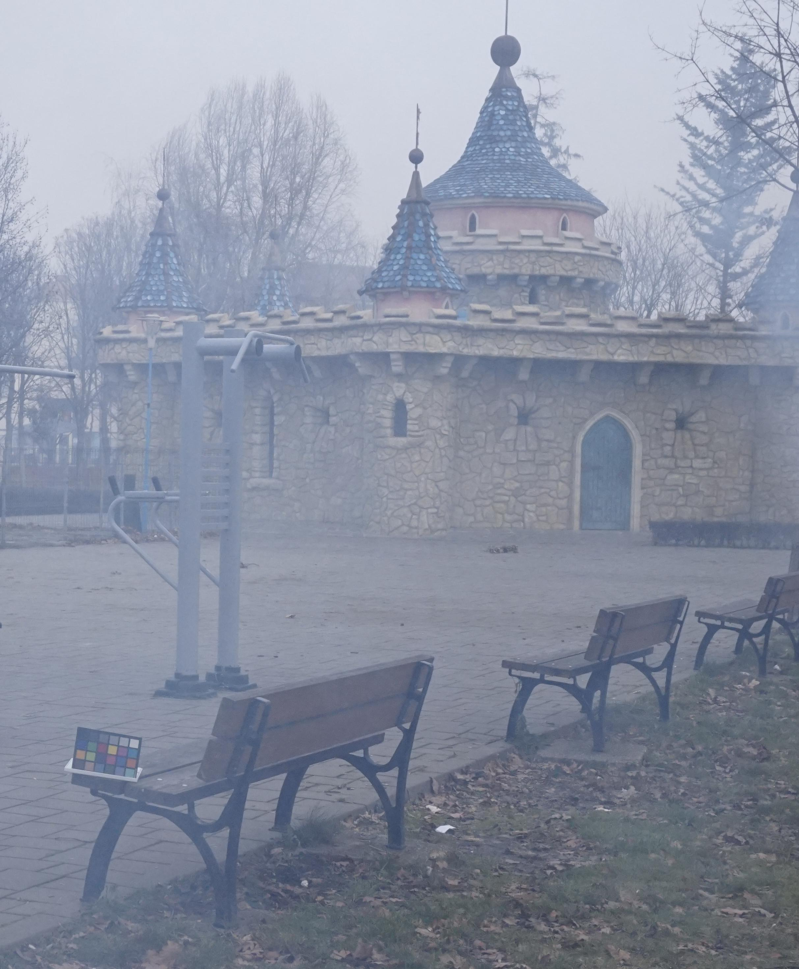

Slide 15
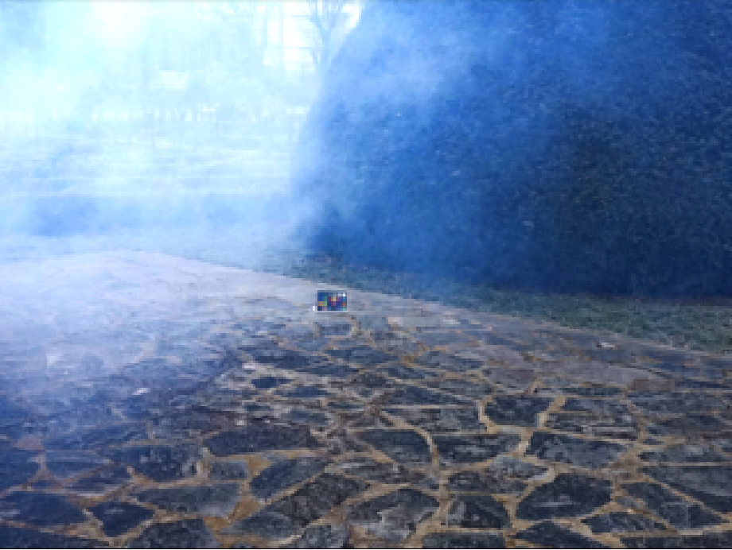
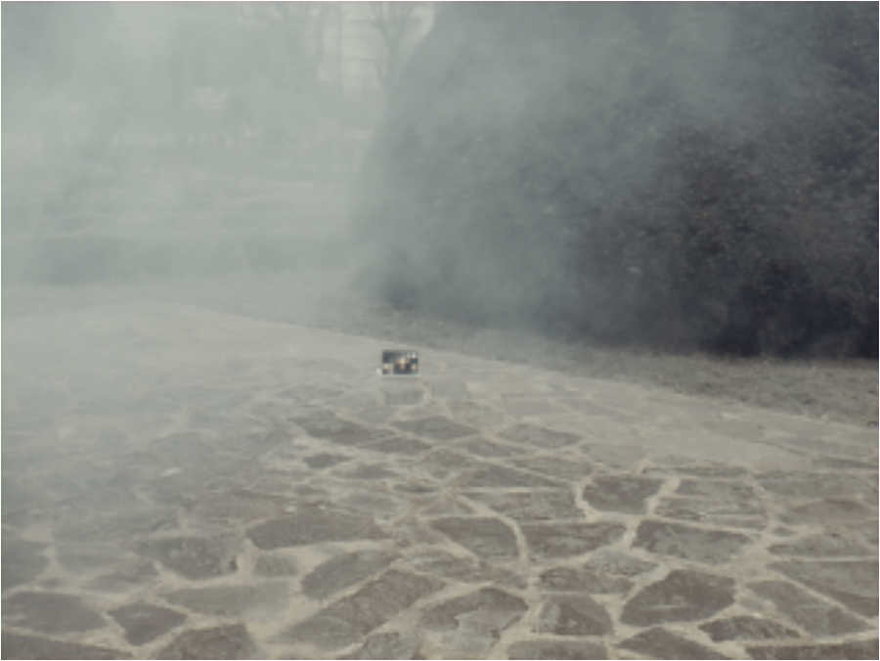
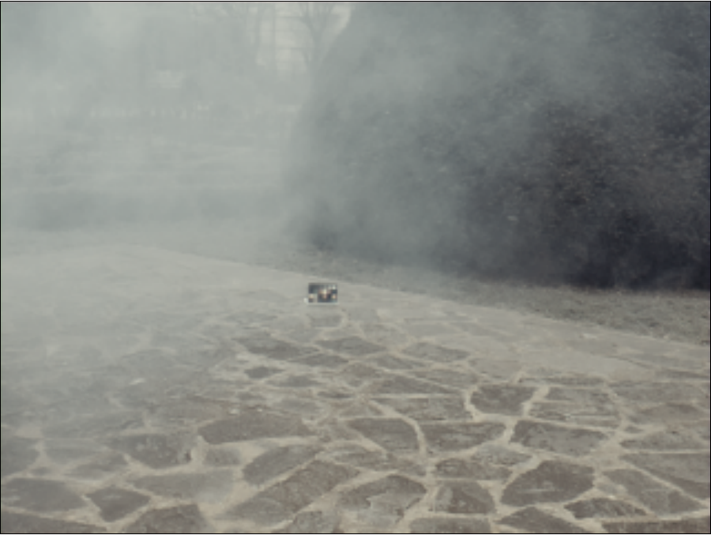
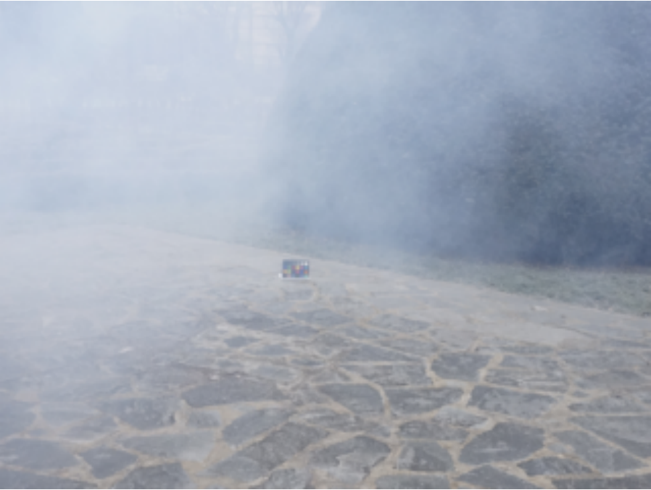
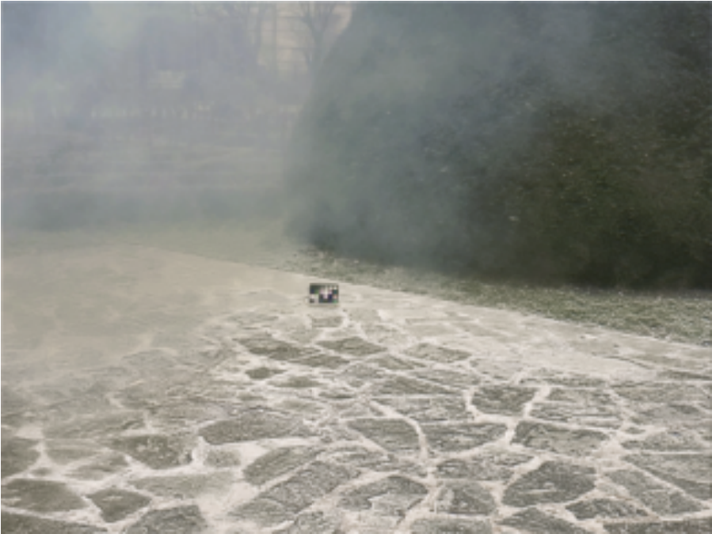
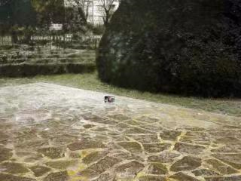
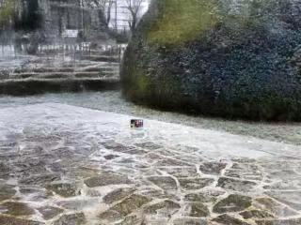
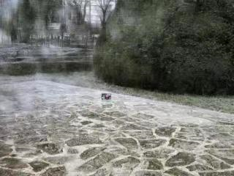
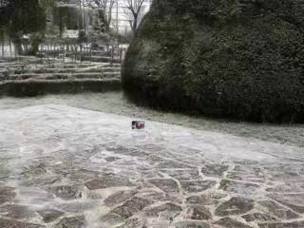
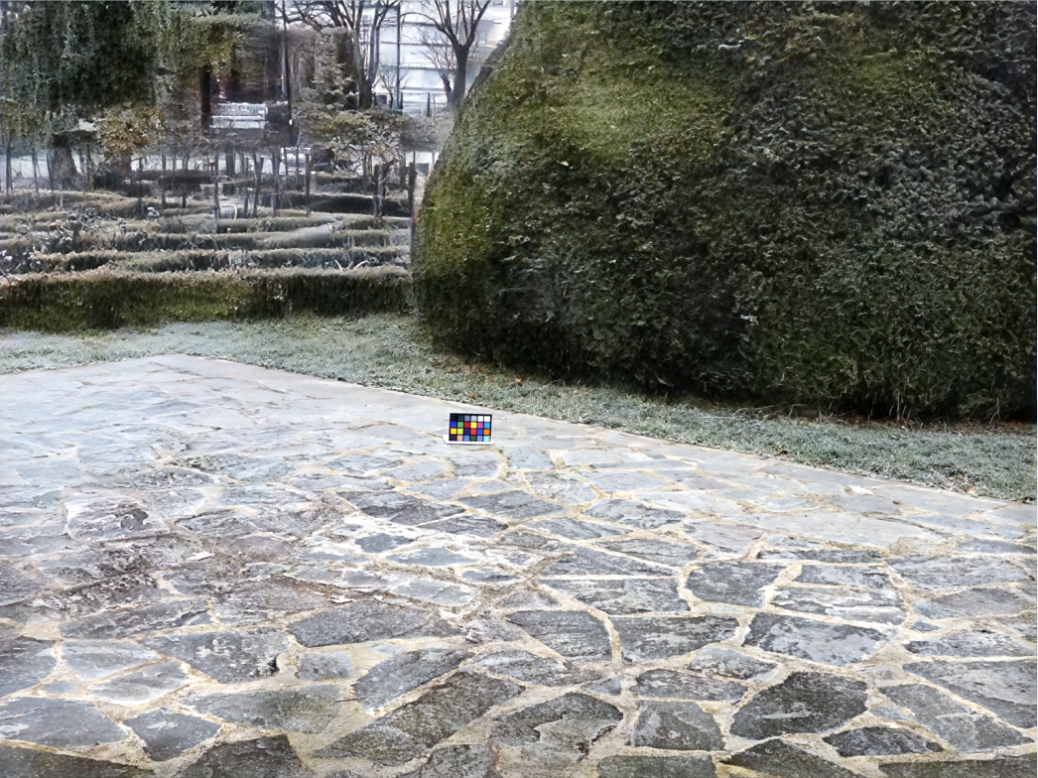
(a)DCP^{[12]}
(b)DehazeNet^{[13]}
(c)AOD-Net^{[44]}
(j)Hazy input
(d)GridDehazeNet^{[45]}
(e)FFA-Net^{[46]}
(f)MSBDN^{[47]}
(k)Ground-truth
(g)KDDN^{[48]}
(h)AECR-Net^{[49]}
(i)Ours

Slide 16
(a)DCP
(b)DehazeNet
(c)AOD-Net
(j)Hazy input
(d)GridDehazeNet
(e)FFA-Net
(f)MSBDN
(k)Ground-truth
(g)KDDN
(h)AECR-Net
(i)Ours

Slide 17
(a)DCP
(b)DehazeNet
(c)AOD-Net
(j)Hazy input
(d)GridDehazeNet
(e)FFA-Net
(f)MSBDN
(k)Ground-truth
(g)KDDN
(h)AECR-Net
(i)Ours

Slide 18
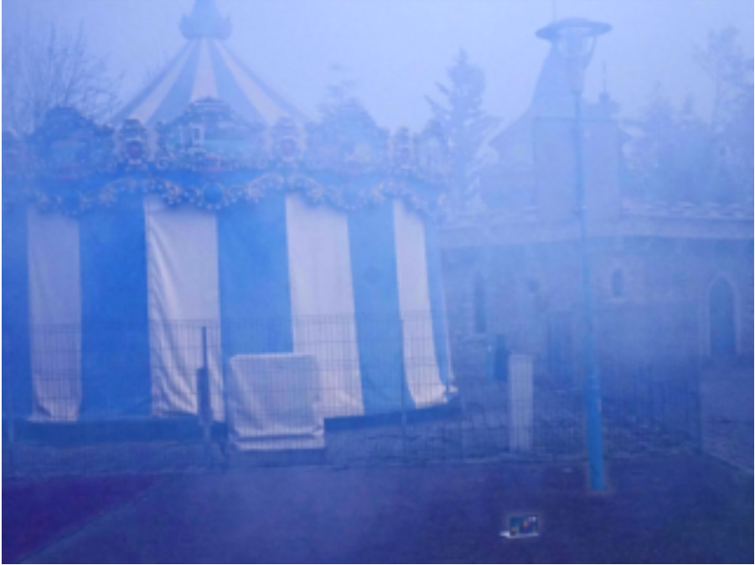
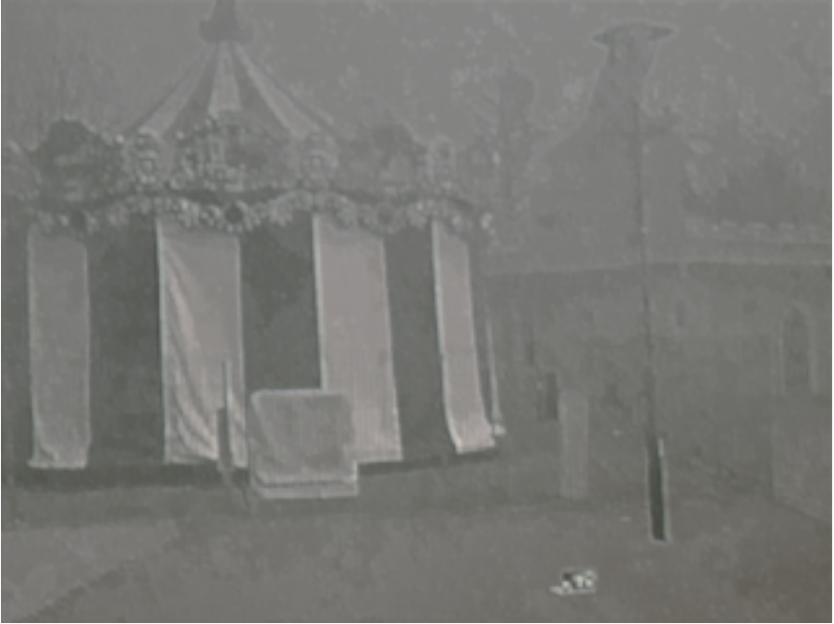
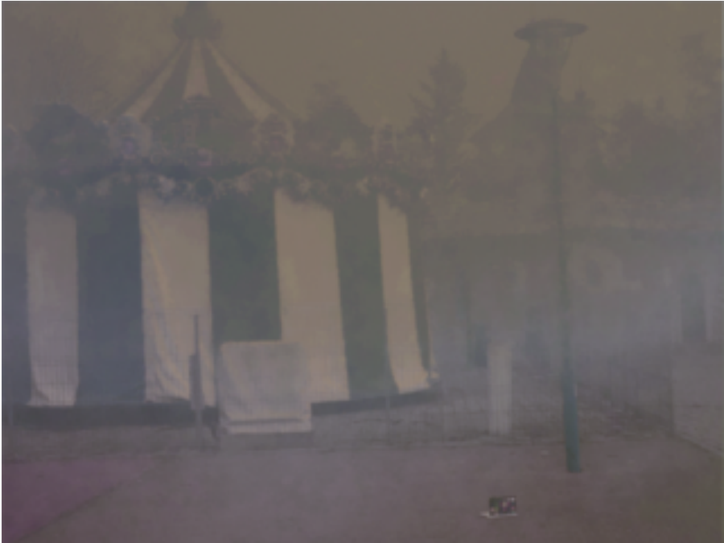
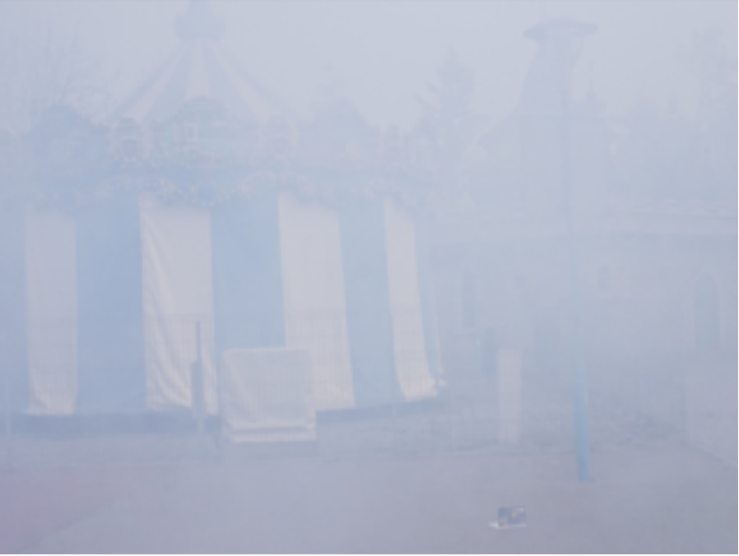
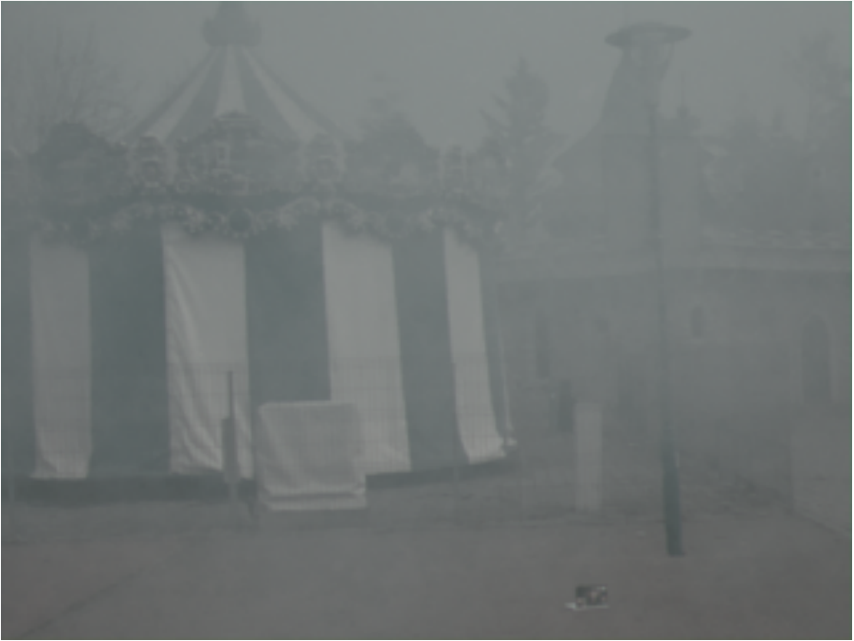
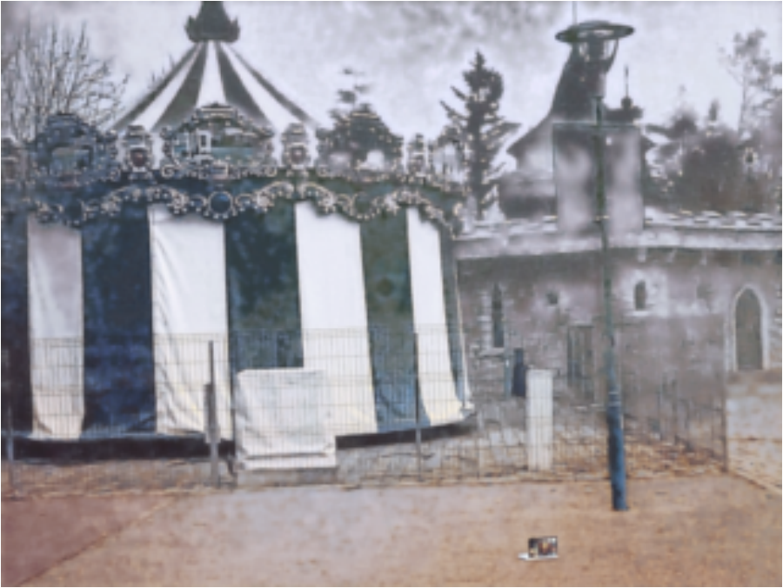
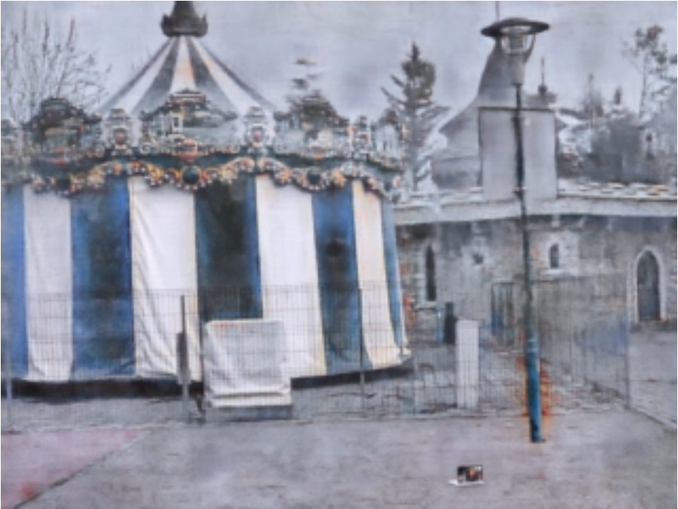

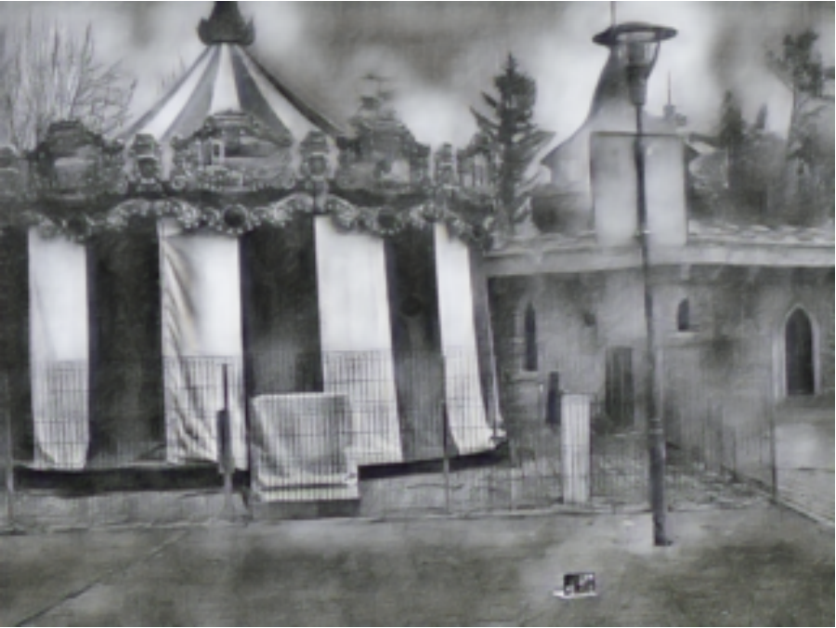
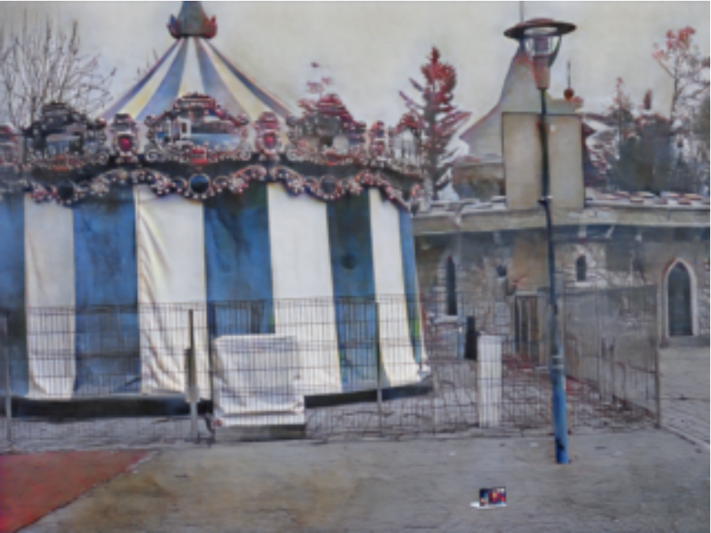
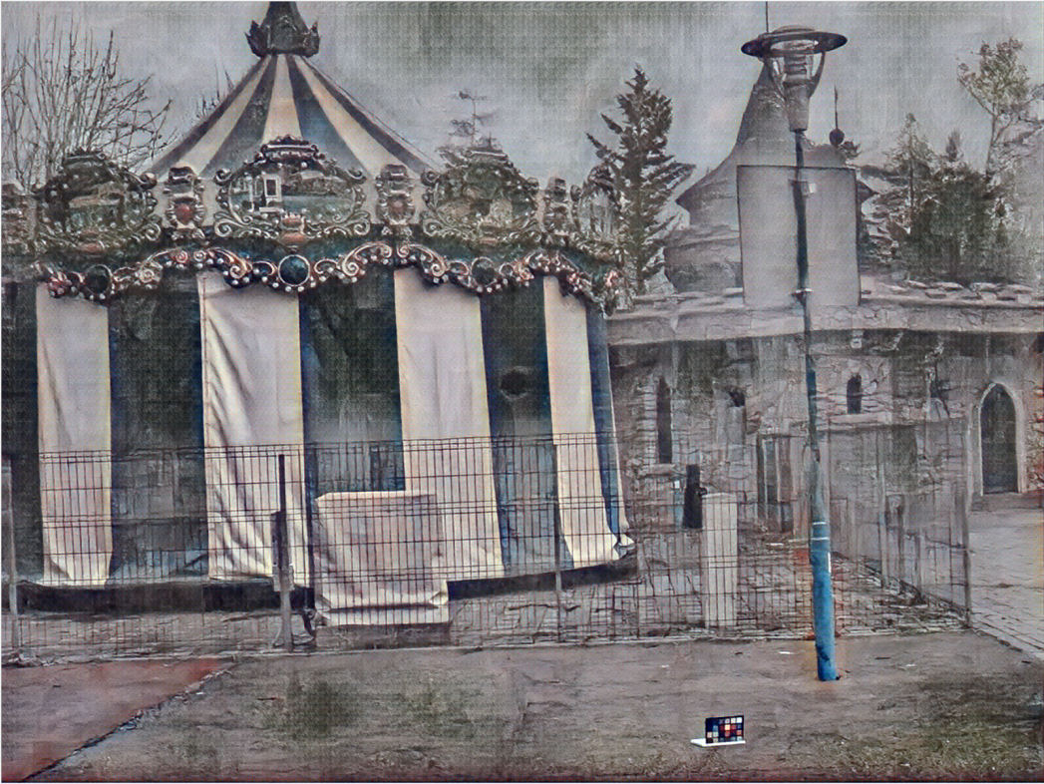
(a)DCP
(b)DehazeNet
(c) AOD-Net
(j) Hazy input
(d)GridDehazeNet
(e) FFA-Net
(f) MSBDN
(k) Ground-truth
(g)KDDN
(h) AECR-Net
(i) Ours

Slide 19
(a)DCP
(b)DehazeNet
(c) AOD-Net
(j) Hazy input
(d)GridDehazeNet
(e) FFA-Net
(f) MSBDN
(k) Ground-truth
(g)KDDN
(h) AECR-Net
(i) Ours

Slide 20
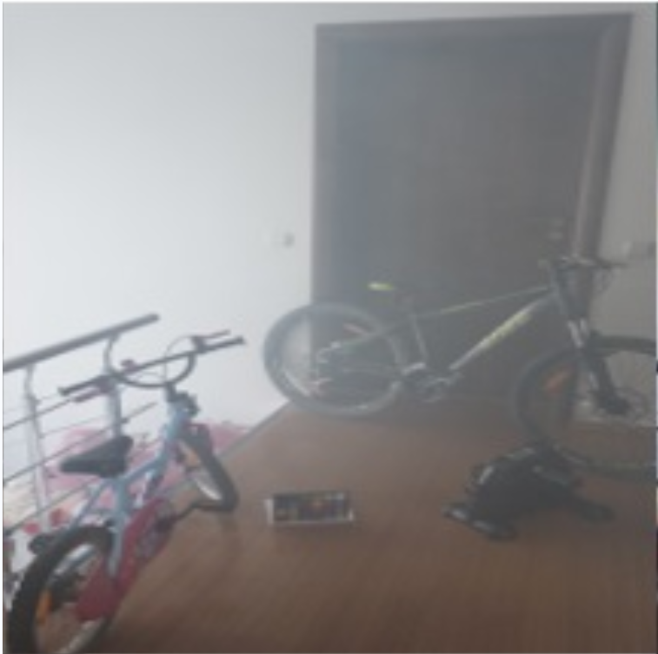
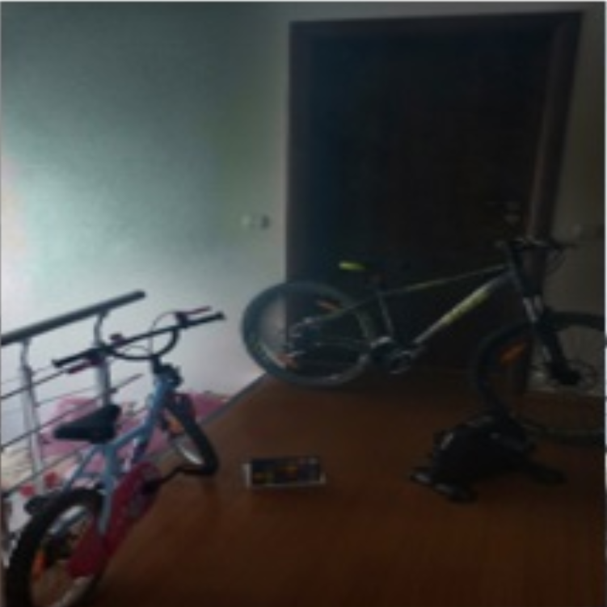
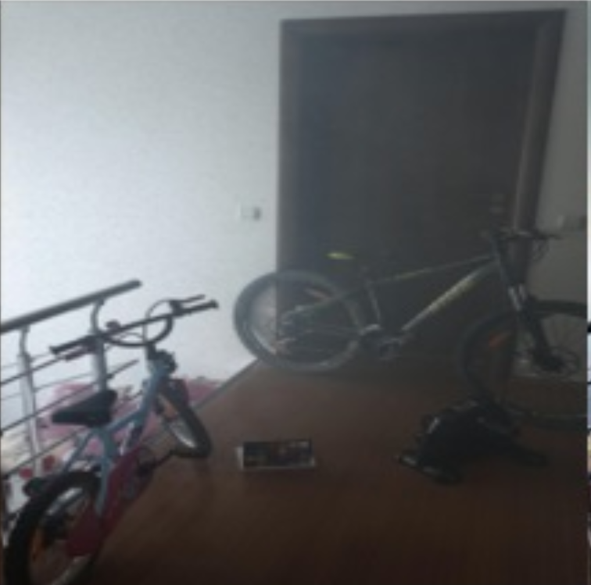
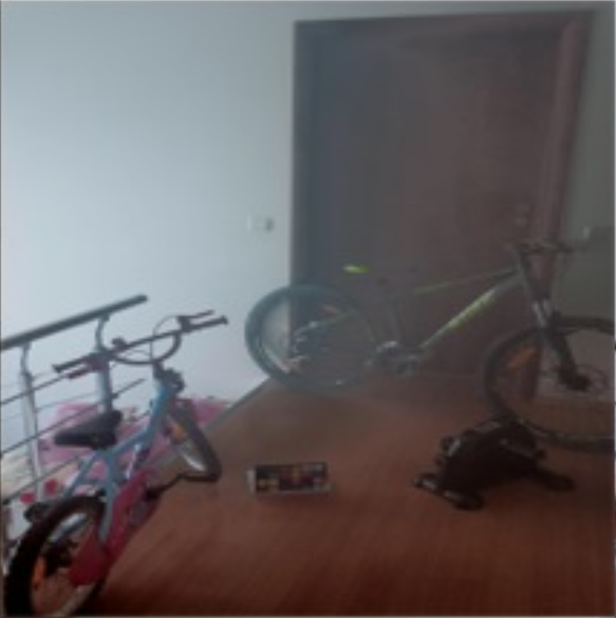
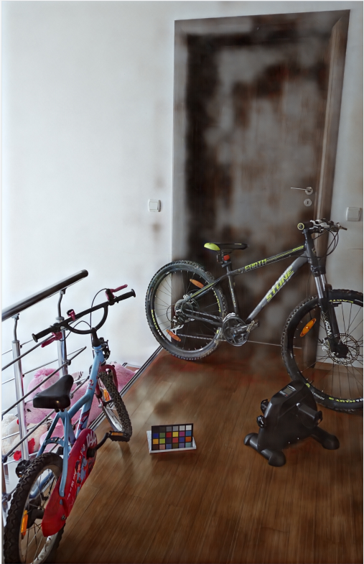
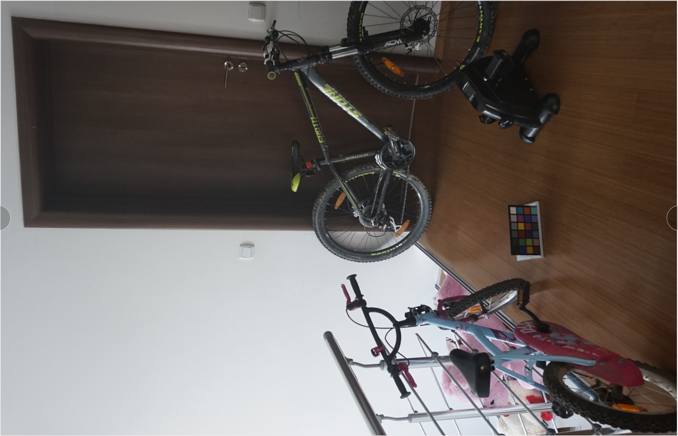

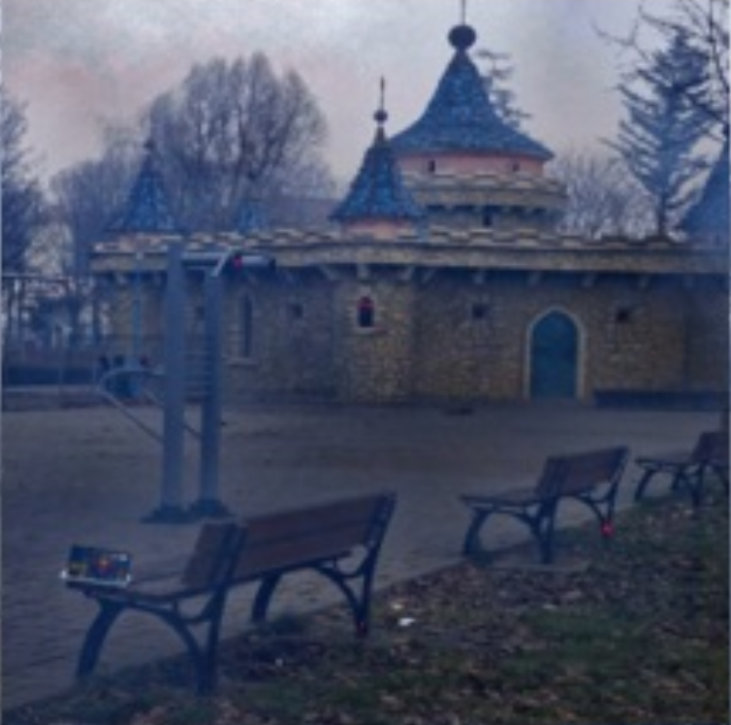
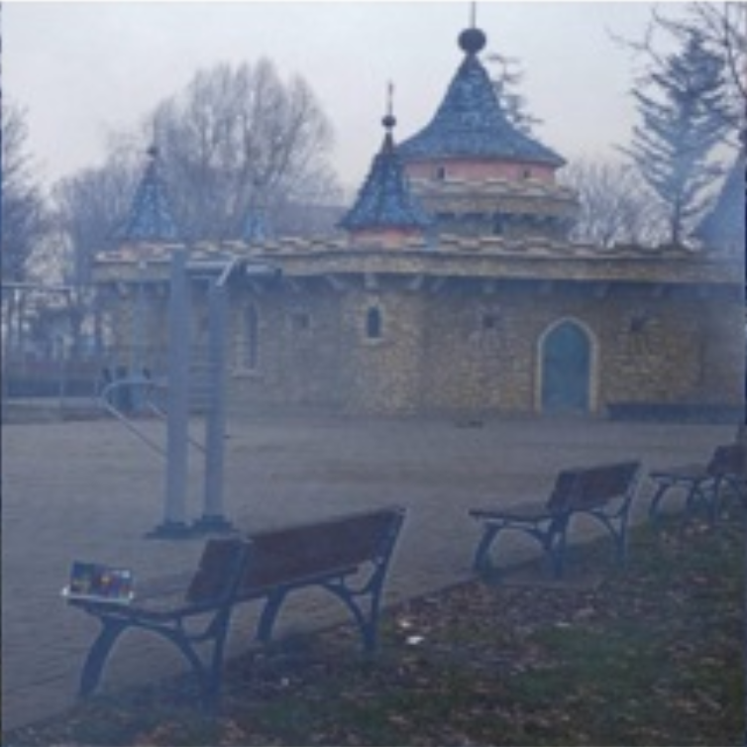
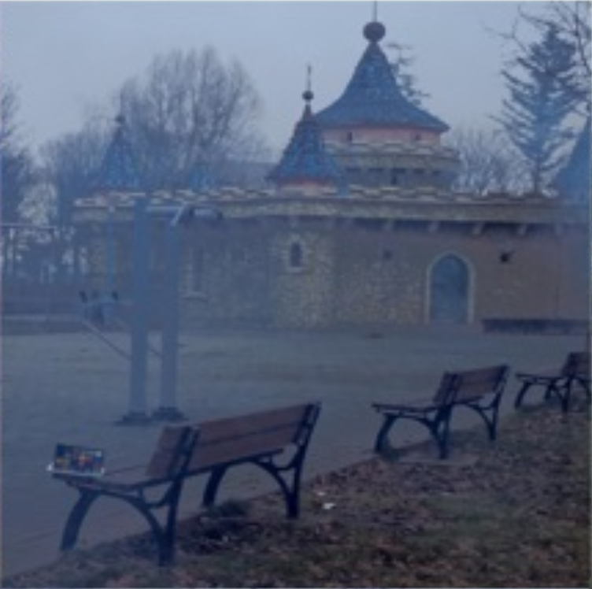
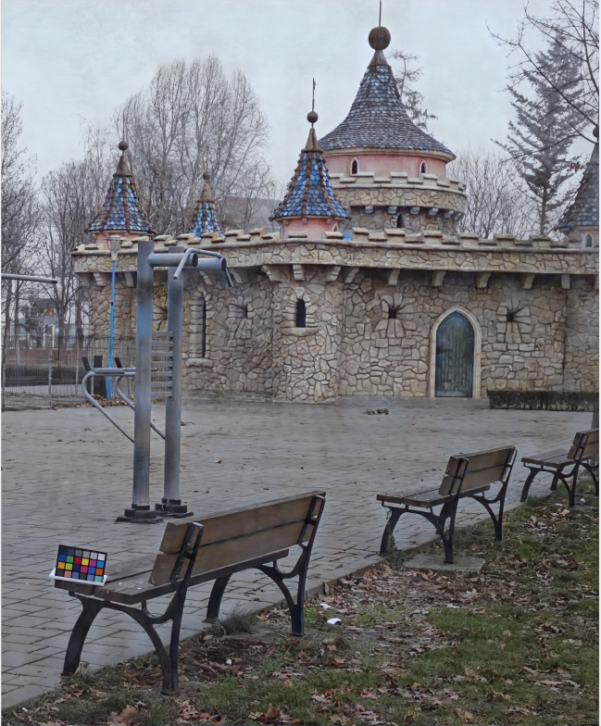
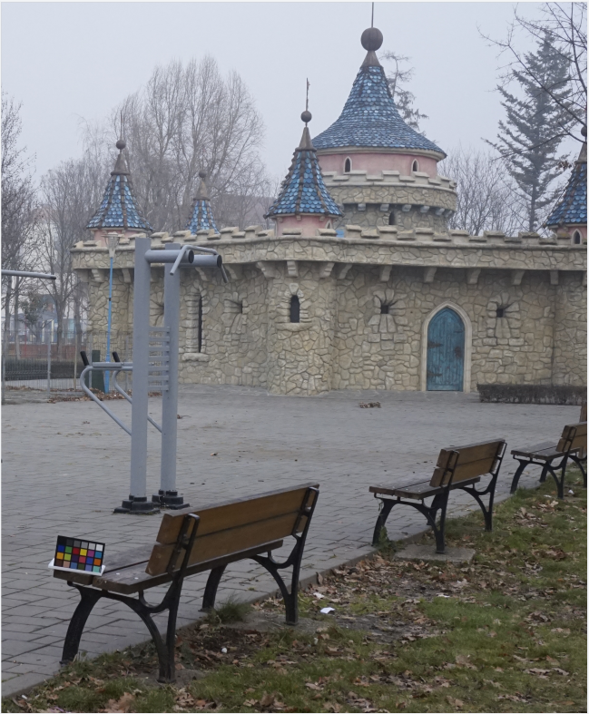
Hazy input
DCP
CAP
AOD-Net
Ours
Ground-truth
I-HAZE
O-HAZE

Slide 21
Hazy input
DCP
CAP
AOD-Net
Ours
Ground-truth
I-HAZE
O-HAZE

Slide 22
Hazy input
DCP
CAP
AOD-Net
Ours
Ground-truth
I-HAZE
O-HAZE

Slide 24
(a)Hazy input
(b)DCP
(c)CAP
(a)Hazy input
(b)DCP
(c)CAP
(d)AOD-Net
(e)Ours
(f)Ground-truth
(d)AOD-Net
(e)Ours
(f)Ground-truth

Slide 25
(a)Hazy input
(b)DCP
(c)CAP
(d)AOD-Net
(e)Ours
(f)Ground-truth

Slide 26




Hazy input
DCP
CAP
AOD-Net
Ours
(i) Ground-truth
I-HAZE

Slide 27

dehazed-ihaze.jpg

Slide 28

dehazed-ohaze.jpg

